Slide 1

Energy Management: Solar Energy Management

Slide 2
Problem Statement
Solar power is one of the fastest growing renewable energy sources but, it has a major challenge: it's highly dependent on cloud cover, which makes generation unpredictable.
Solar energy depends on sunlight, and cloud movements.
Our idea is to use sky images along with solar radiation values to build a deep learning model that can forecast solar power output in the next 30 minutes.”

Slide 3
Ideation
📑 Search: Researched from IEEE(Institute of Electrical and Electronics Engineer) papers, And some guidelines from different web portals.
📷 Idea: Use sky camera images + solar irradiance data to learn cloud movement patterns.
🧠 Approach: Train a ConvLSTM(Convolutional Long Short-Term Memory) deep learning model that captures both spatial (cloud shapes) and temporal (cloud motion) features.
🎯 Goal: Forecast solar irradiance 30 minutes ahead, enabling better energy management and grid stability.

Slide 4
Methodology
1. Data Sourcing:
Dataset collected from NREL(National Renewable Energy laboratory)
Collect time-stamped sky images and irradiance values (pyranometer).
2. Data Preparation
Create input sequences: e.g., 6 consecutive images.
3. Model Architecture
ConvLSTM2D(Convolutional Long Short-Term Memory) layers → capture cloud features + movements.
Process Sequences of images, learning both the spatial features(clouds) in each image and their temporal evolution(movements)
“Dense layers → predict continuous irradiance output.”

Slide 5
👉 Meaning:
After the ConvLSTM part, we add Dense (fully connected) layers.
These act like a calculator that combines all learned features to give the final prediction (irradiance value).
It’s like:
ConvLSTM = eyes + memory (understand clouds + movement).
Dense = brain’s calculator (give the final number).
4. Training:
It's is regression task
Optimizer: Adam
Regression Loss function: MSE(Mean Squared Error) / MAE(Mean Absolute Error)
5. Evaluation:
Evaluate the model using regression:
Metrics: RMSE(Root Mean Squared Error) and MAE on a test set
Visualization: Predicted vs Actual irradiance plots.

Slide 6
How This Problem Statement Is Useful / Impactful:
✅ 1. Improves Solar Energy Utilization
By predicting when and how much sunlight will be available, grid operators can better schedule and manage power generation.
Helps in reducing reliance on fossil fuel backup.
✅ 2. Enhances Grid Stability
Sudden drops in solar output (e.g., due to clouds) can cause voltage fluctuations or power imbalance.
Accurate forecasts enable the grid to respond proactively, ensuring stability.

Slide 7
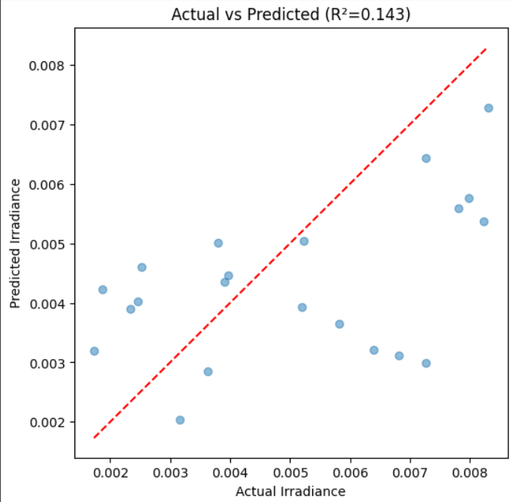
OUTPUT:

Slide 8
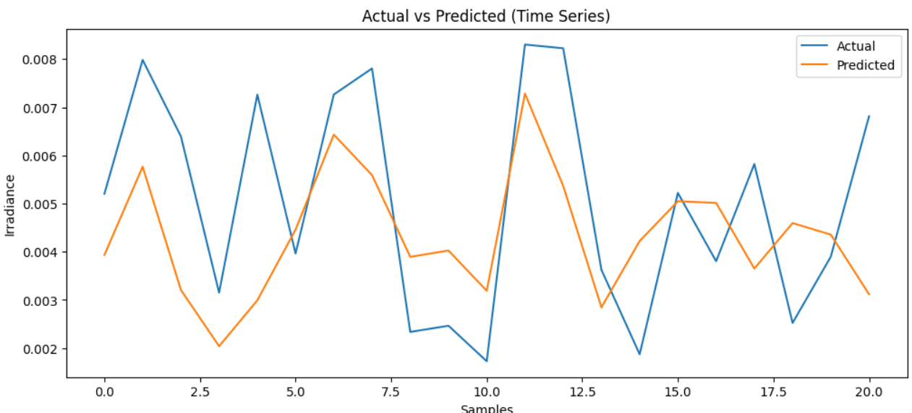

Slide 9
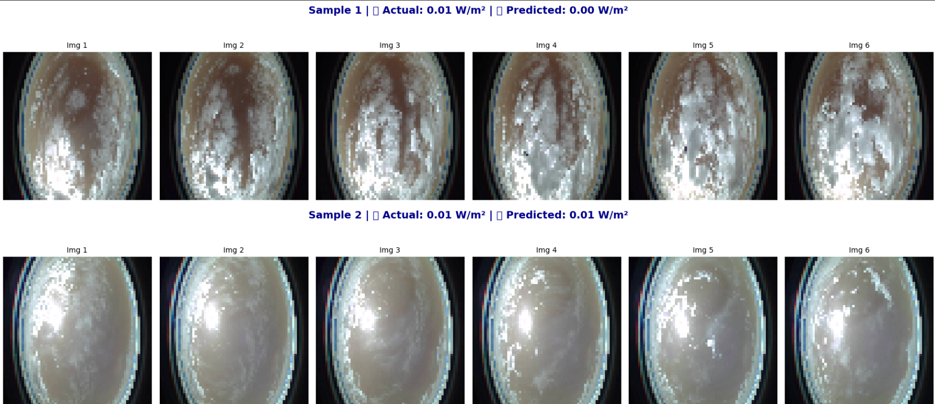

Slide 10
👥 Team Members
L. V. Durga - Team Lead
D. Sowmya
B. D. S. Saranya
K. Sravya
B. Bhargavi Devi
We split the work among us across different roles. Collaborating like this helped us learn not just technically, but also how to manage tasks as a team
— a valuable experience overall.

Slide 11


